Slide 1
UMET9U-30-1- Professional Skills for Banking and Finance Lecture 19
Presented by
Reinhold Heinlein
March 2026

Slide 2
Lecture content
Revision of normal probability distributions (see also lecture 12)
Statistical inference
Sampling distribution of the mean
Central limit theorem

Slide 3
Normal distribution
Characteristics of any normal distribution:
Bell-shaped
Symmetric about mean
Continuous
Never touches the x-axis
Total area under curve is 1.00
Approximately 68% lies within 1 standard deviation of the mean, 95% within 2 standard deviations, and 99.7% within 3 standard deviations of the mean.

Slide 4

Normal distribution
Data values represented by x which follows a normal distribution, has mean $μ$ and variance $σ^{2}$.
$$x\sim N(μ, σ^{2})$$

Slide 5
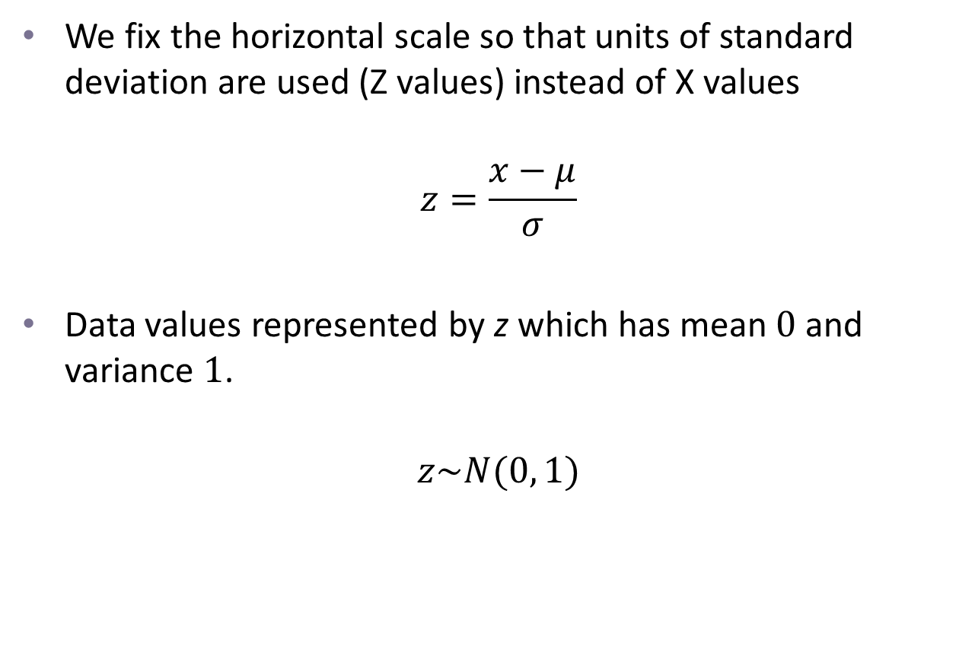
The standard normal curve
We fix the horizontal scale so that units of standard deviation are used (Z values) instead of X values
$$z=\frac{x−μ}{σ}$$
Data values represented by z which has mean $0$ and variance $1$.
$$z\sim N(0, 1)$$

Slide 6
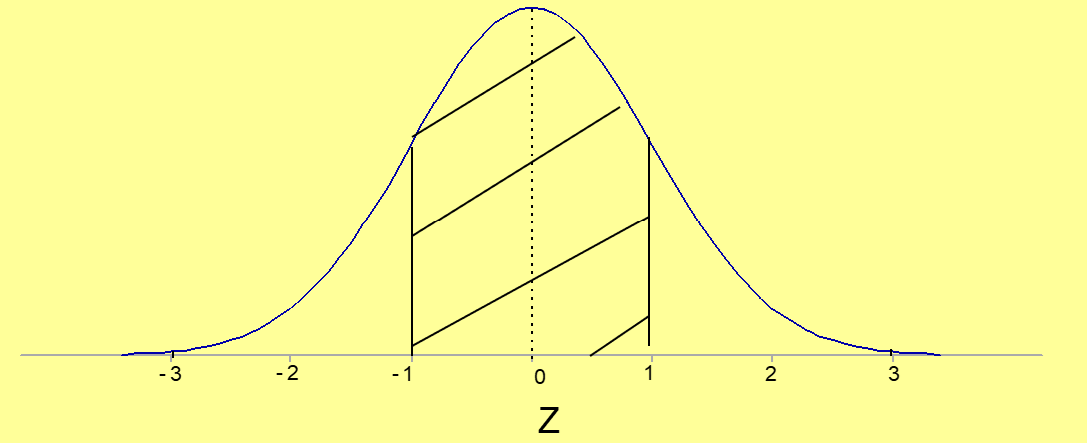
Areas under the curve
Areas under the curve can be looked up on the Z table.
There is a probability of 0.68 that a value will lie in this region.

Slide 7
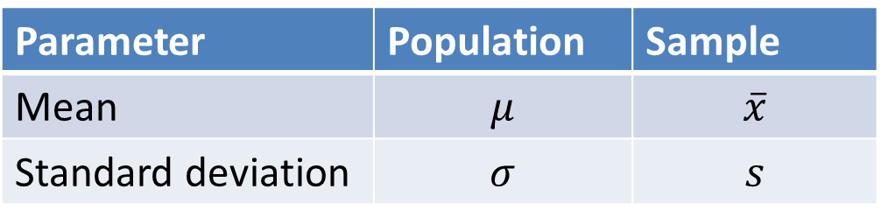
Population and samples
A population refers to all items of interest
A sample is a small subset of the population
The sample should be chosen at random so that it is representative of the population
We use a sample to infer something about the population
Different samples give different results
Symbols:
Parameter | Population | Sample
Mean | $$μ$$ | $$\overline{x}$$
Standard deviation | $$σ$$ | $$s$$

Slide 8
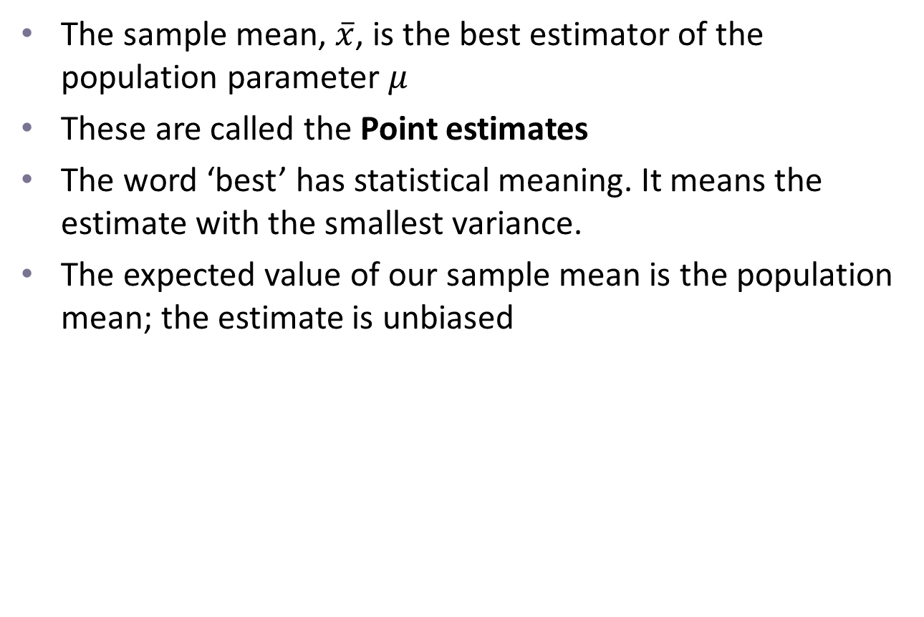
Best estimates of the parameters
The sample mean, $\overline{x}$, is the best estimator of the population parameter $μ$
These are called the Point estimates
The word ‘best’ has statistical meaning. It means the estimate with the smallest variance.
The expected value of our sample mean is the population mean; the estimate is unbiased

Slide 9
Sampling distribution of the mean
If you took lots of samples from any distribution with finite variance, the distribution of the sample mean would be approximately normal
This is the central limit theorem, which is a very important result in statistics.

Slide 10
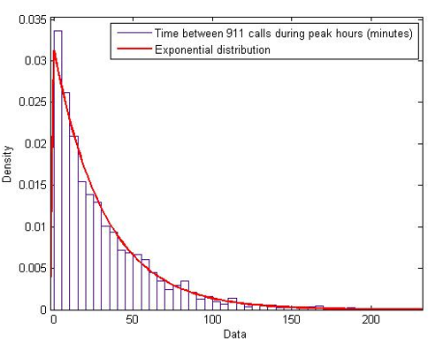
Sampling distribution of the mean
Even in this highly non-normal population, repeated sample means will be approximately normal. This is essentially because they can be too high or too low in equal measure.

Slide 11
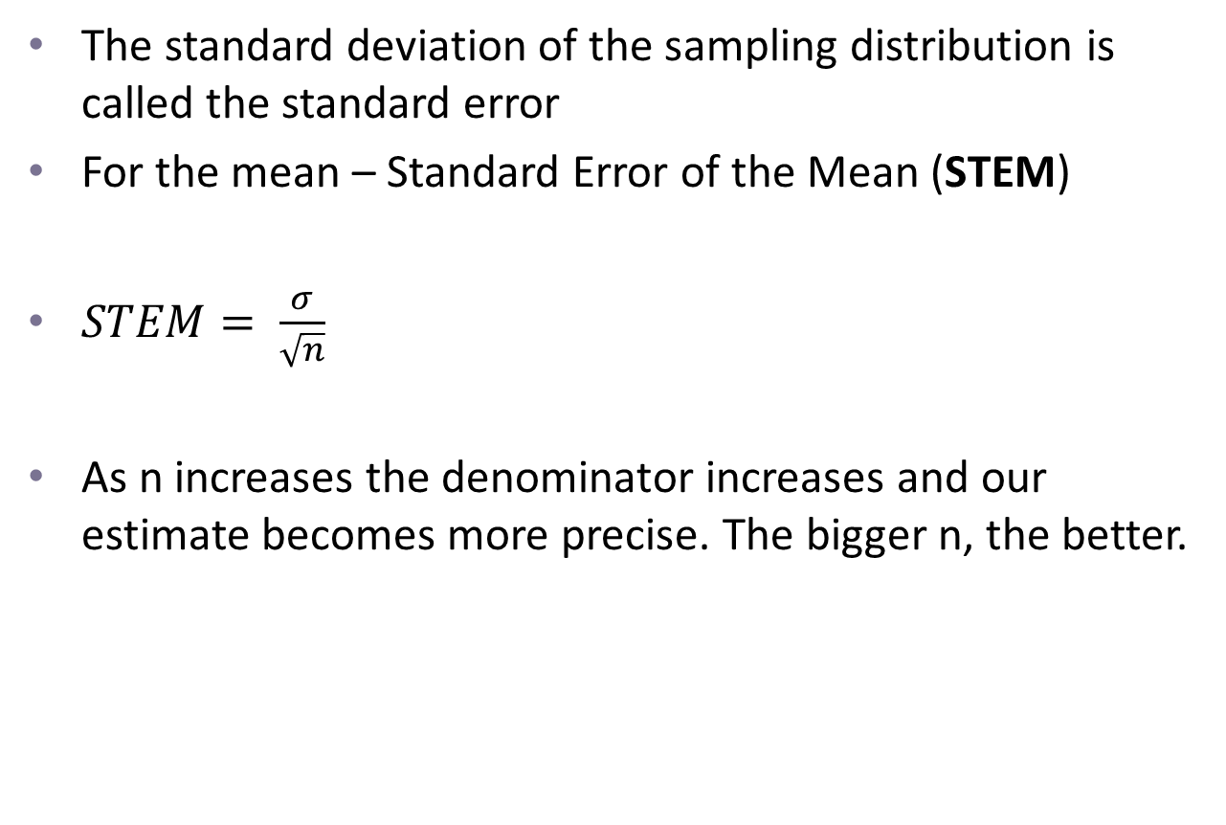
Standard error
The standard deviation of the sampling distribution is called the standard error
For the mean – Standard Error of the Mean (STEM)
$STEM= \frac{σ}{\sqrt{n}}$
As n increases the denominator increases and our estimate becomes more precise. The bigger n, the better.

Slide 12
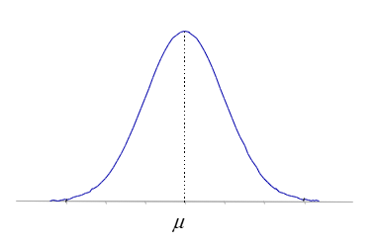
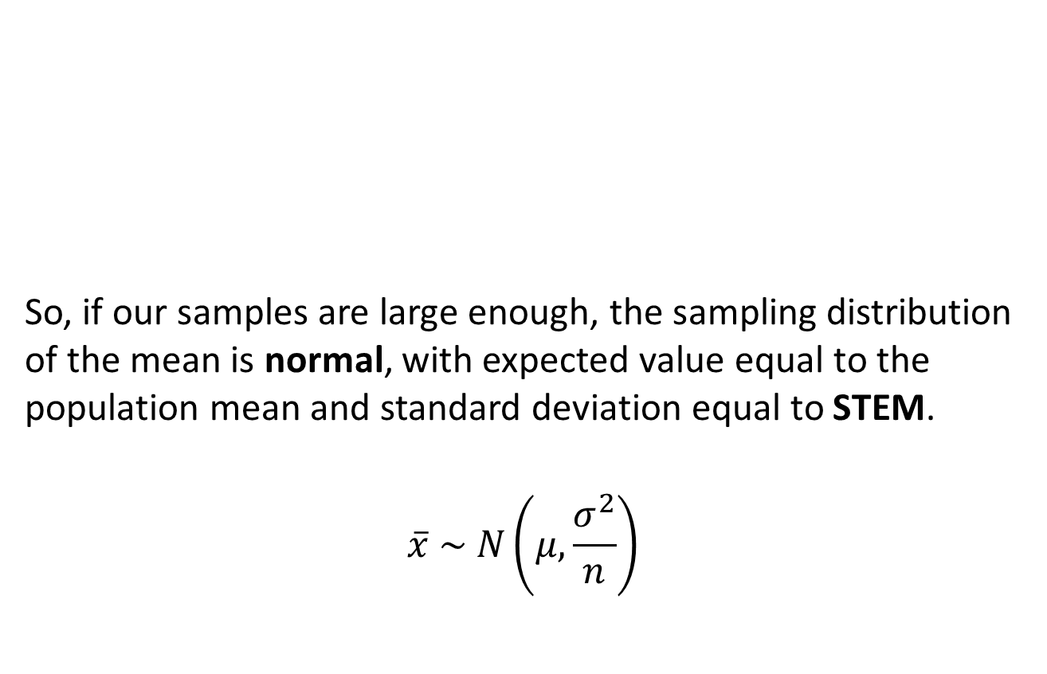
Distribution of sample means
So, if our samples are large enough, the sampling distribution of the mean is normal, with expected value equal to the population mean and standard deviation equal to STEM.
$$\overline{x} \sim N\left(μ, \frac{σ^{2}}{n}\right)$$

Slide 13
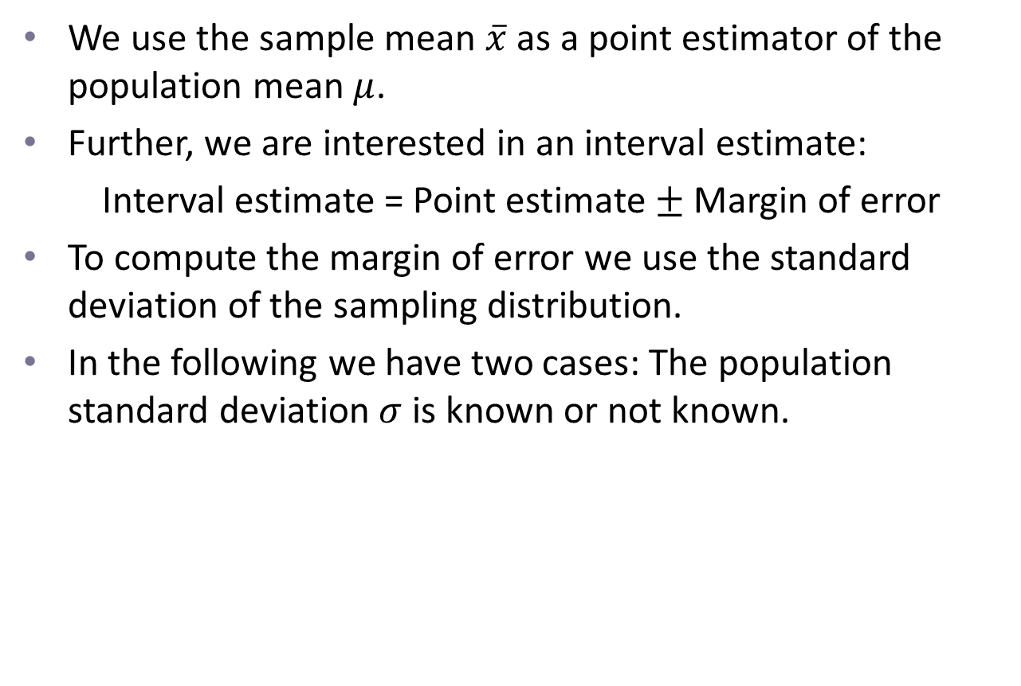
Interval estimation
We use the sample mean $\overline{x}$ as a point estimator of the population mean $μ$.
Further, we are interested in an interval estimate:
Interval estimate = Point estimate $±$ Margin of error
To compute the margin of error we use the standard deviation of the sampling distribution.
In the following we have two cases: The population standard deviation $σ$ is known or not known.

Slide 14
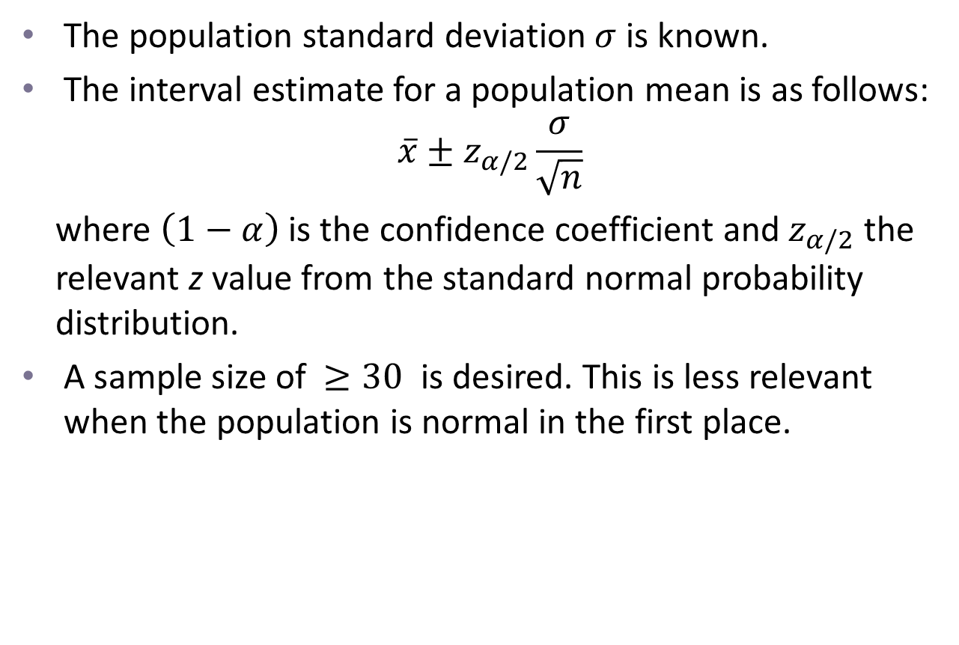
Case 1: 𝜎 is known
The population standard deviation $σ$ is known.
The interval estimate for a population mean is as follows:
$$\overline{x}±z_{α/2}\frac{σ}{\sqrt{n}}$$
where $\left(1−α\right)$ is the confidence coefficient and $z_{α/2}$ the relevant z value from the standard normal probability distribution.
A sample size of $≥30$ is desired. This is less relevant when the population is normal in the first place.

Slide 15
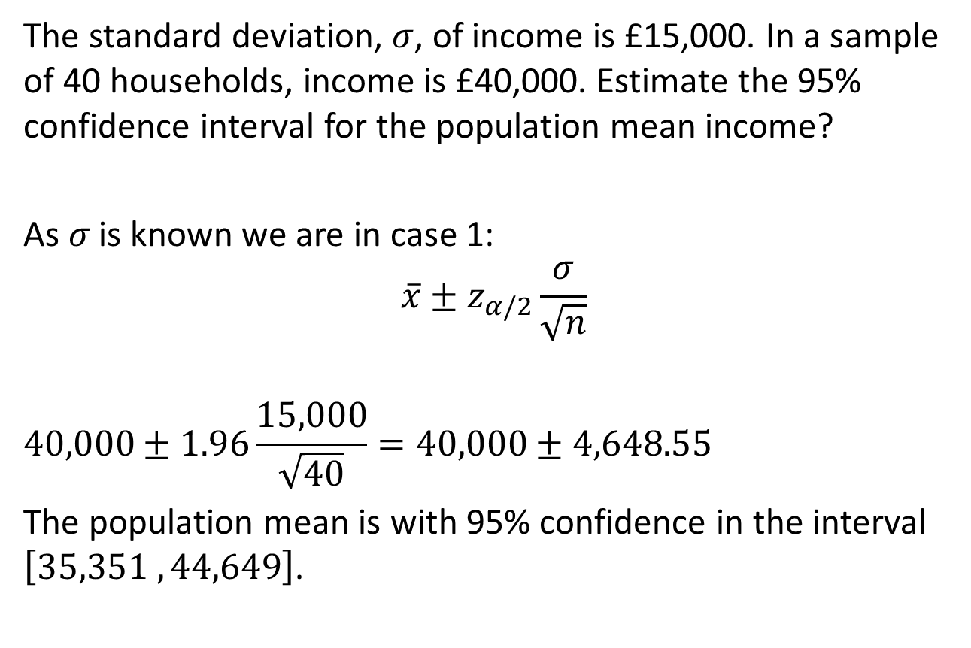
Example 1
The standard deviation, $σ$, of income is £15,000. In a sample of 40 households, income is £40,000. Estimate the 95% confidence interval for the population mean income?
As 𝜎 is known we are in case 1:
$$\overline{x}±z_{α/2}\frac{σ}{\sqrt{n}}$$
$$40,000±1.96\frac{15,000}{\sqrt{40}}=40,000±4,648.55$$
The population mean is with 95% confidence in the interval $\left[35,351 , 44,649\right]$.

Slide 16
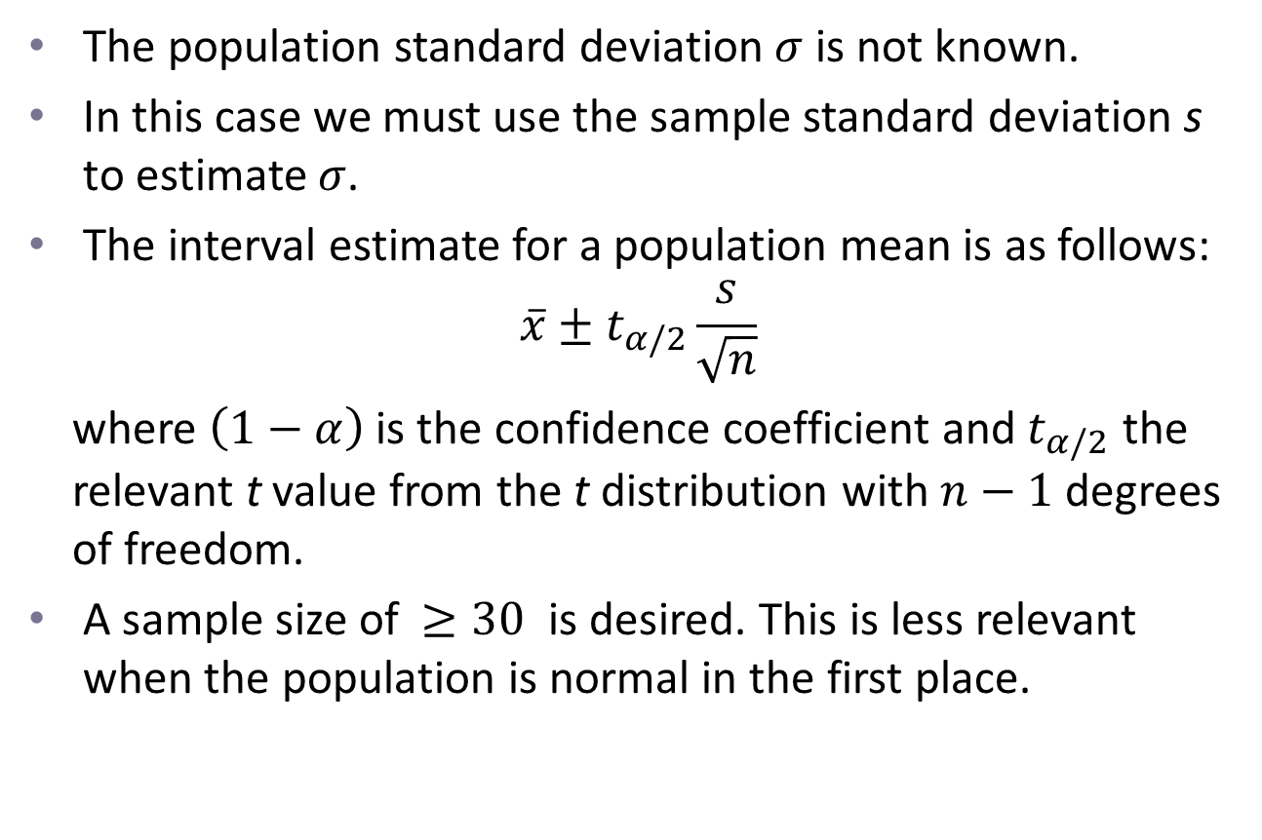
Case 2: 𝜎 is unknown
The population standard deviation $σ$ is not known.
In this case we must use the sample standard deviation s to estimate $σ$.
The interval estimate for a population mean is as follows:
$$\overline{x}±t_{α/2}\frac{s}{\sqrt{n}}$$
where $\left(1−α\right)$ is the confidence coefficient and $t_{α/2}$ the relevant t value from the t distribution with $n−1$ degrees of freedom.
A sample size of $≥30$ is desired. This is less relevant when the population is normal in the first place.

Slide 17
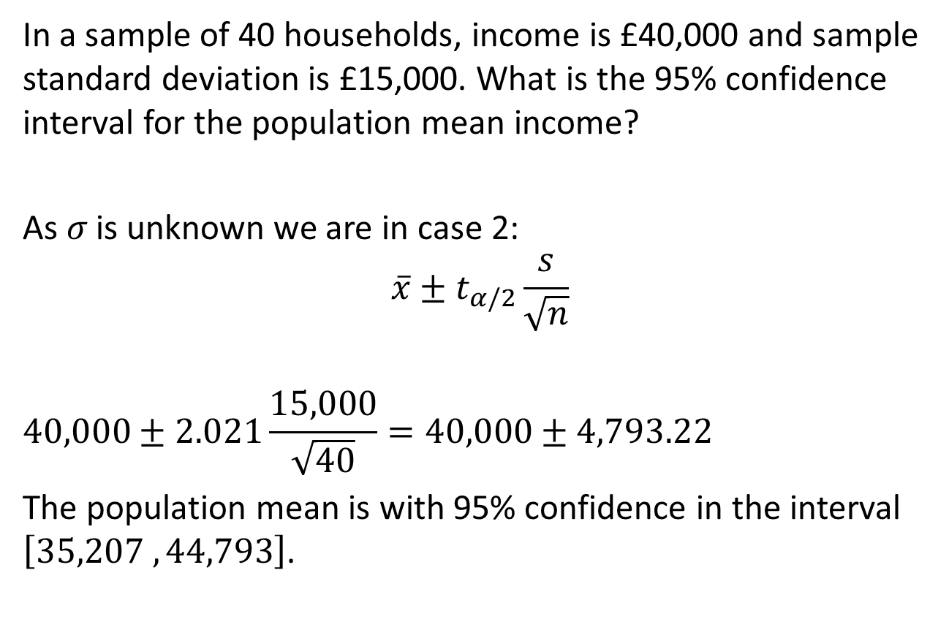
Example 2
In a sample of 40 households, income is £40,000 and sample standard deviation is £15,000. What is the 95% confidence interval for the population mean income?
As 𝜎 is unknown we are in case 2:
$$\overline{x}±t_{α/2}\frac{s}{\sqrt{n}}$$
$$40,000±2.021\frac{15,000}{\sqrt{40}}=40,000±4,793.22$$
The population mean is with 95% confidence in the interval $\left[35,207 , 44,793\right]$.

Slide 18
Next Lecture
Hypothesis testing

